Slide 1
DyslexiScan: Empowering Individuals with Dyslexia
Enhancing Reading Accessibility through Innovative Technology
Notes:
D : Hi everyone, and welcome! Today, we the students of SRDAV would like to introduce you to DyslexiScan, an innovative app designed to bridge the gap in reading comprehension for people with and without dyslexia. So Veerjyot, Can you tell us about Dyslexia ?

Slide 2

Definition of Dyslexia
Dyslexia is a learning difference that makes it hard for some people to read, write, and spell. It can affect things like seeing letters clearly, understanding sounds in words, and putting words in order. It doesn't mean someone is less intelligent, just that their brain works differently. A condition of neurodevelopmental origin that mainly affects the ease with which a person reads, writes, and spells, typically recognized as a specific learning disorder in children.
Notes:
V: Yes OFC, Dyslexia is a condition of neurodevelopmental (learning difference) that affects a person's ability to read, write, and spell. It's important to understand that dyslexia isn't a sign of lower intelligence, but rather a different way the brain processes information. Around 780 million people around the world suffer from Dyslexia while in USA around 40 million adults have dyslexia but only 2 million people get diagnosed meaning only 5 percent of population know that they have dyslexia.

Slide 3
Impact on Reading, Writing, and Comprehension
Reading:
Difficulty in decoding words and recognizing spelling patterns.
Challenges in reading fluently and accurately.
Writing:
Struggles with spelling and grammar.
Difficulty in organizing thoughts and expressing ideas coherently.
Comprehension:
Challenges in understanding and interpreting written language.
Difficulty in grasping complex sentences and extracting key information.
Notes:
D : One common challenge for people with dyslexia is that written text can appear scrambled or flipped around. This can make it difficult for others to understand what they've written.

Slide 4
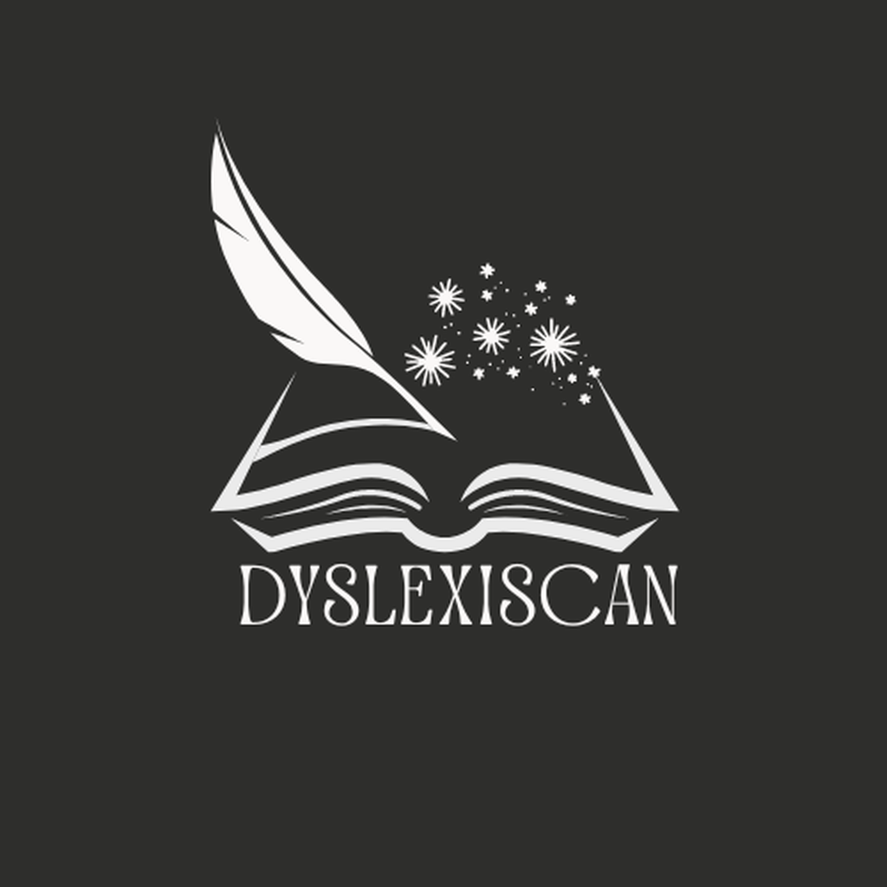
Introducing: DyslexiScan
Despite advancements in technology, individuals with dyslexia struggle with reading and comprehending written content, limiting their access to education and opportunities. Existing solutions may lack integration and real-time support. There is a need for an innovative, user-friendly app that seamlessly integrates text recognition, dyslexic text conversion, and text-to-speech features to empower individuals with dyslexia enhancing their experience.
Notes:
V : DyslexiScan is an innovative app that leverages cutting-edge technology to close this exact gap. It helps people with dyslexia by transforming what they have written into a format that's easier to understand for everyone. This can boost confidence and empower individuals with dyslexia to express themselves clearly.

Slide 5
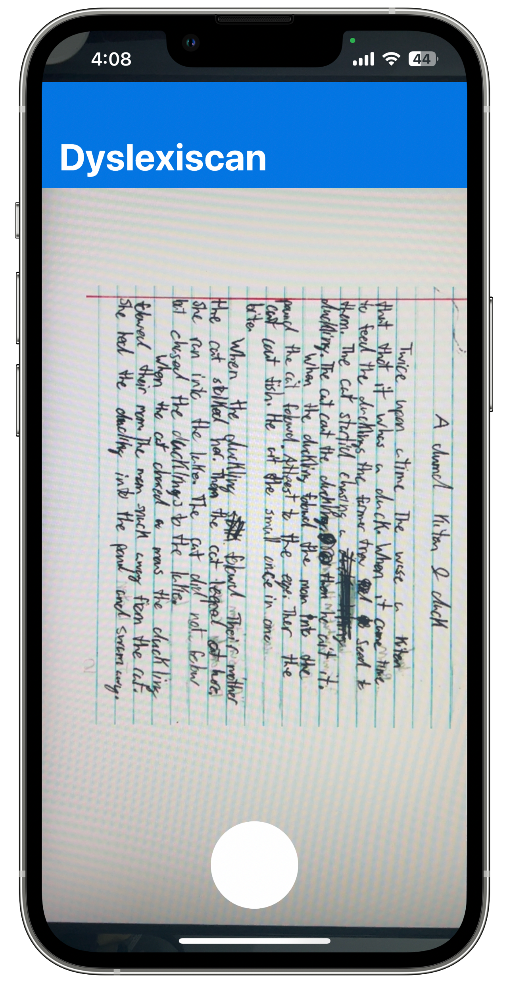
Quick demonstration
To you use the app you only need to click the photo of dyslexic text and wait for the magic to happen.
The app will automatically extract text from image , check for minor spelling errors and then will send it to Gemini for further processing.
Notes:
D : Let's take a quick look at how DyslexiScan works!

Slide 6
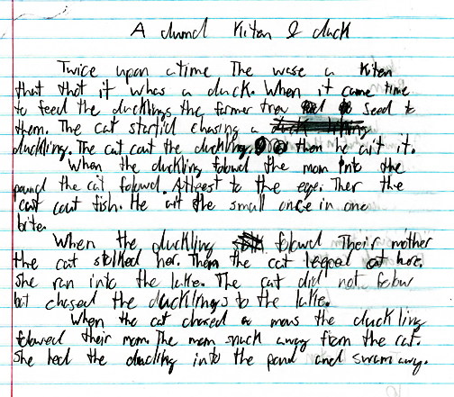
An Example of Dyslexic text written by 7th grade student
Notes:
V : This slide shows an example of how a dyslexic person may write ? Take your time guessing what’s written! .
Let's ask DylexiScan what the 7th grader has written

Slide 7
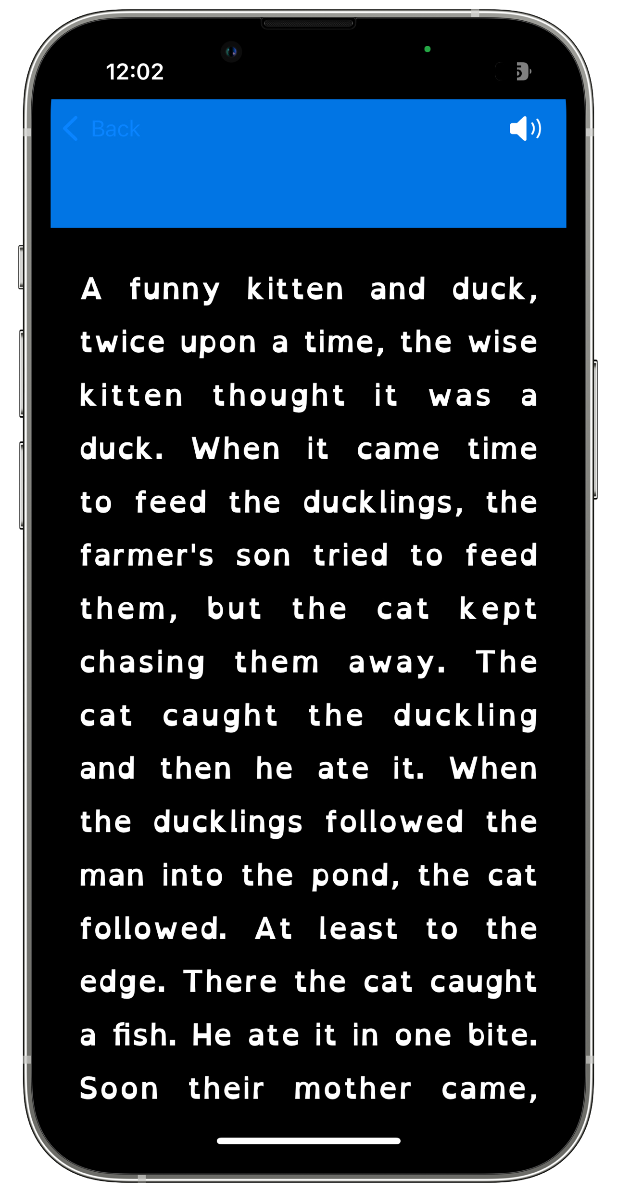
Output for the Dyslexic Text
Notes:
D : Well it’s a story about a kitten and a duck . Also the font used is Dyslexic Friendly about which we will discuss further in the presentation.

Slide 8
Under the Hood
1. OCR is a technology converts scanned documents or images containing text into editable and searchable digital files, enhancing accessibility and usability
2. Spell checkers assist users in identifying and correcting spelling errors in documents,email or other textual content, enhancing communication clarity and Professionalism.
3.Gemini uses its NLP capabilities to make sense of sentences and convert them into easy-to-read text, including performing spelling checks
3.TTS can be a game-changer for people with reading difficulties. It allows them to access written information in an auditory format,
Notes:
V : DyslexiScan utilizes a combination of Optical Character Recognition (OCR), a spell checker, Google’s Gemini as a powerful text correction engine and Text to speech. Out of the four only Gemini needs internet connection to work . This results in greater privacy and security.

Slide 9
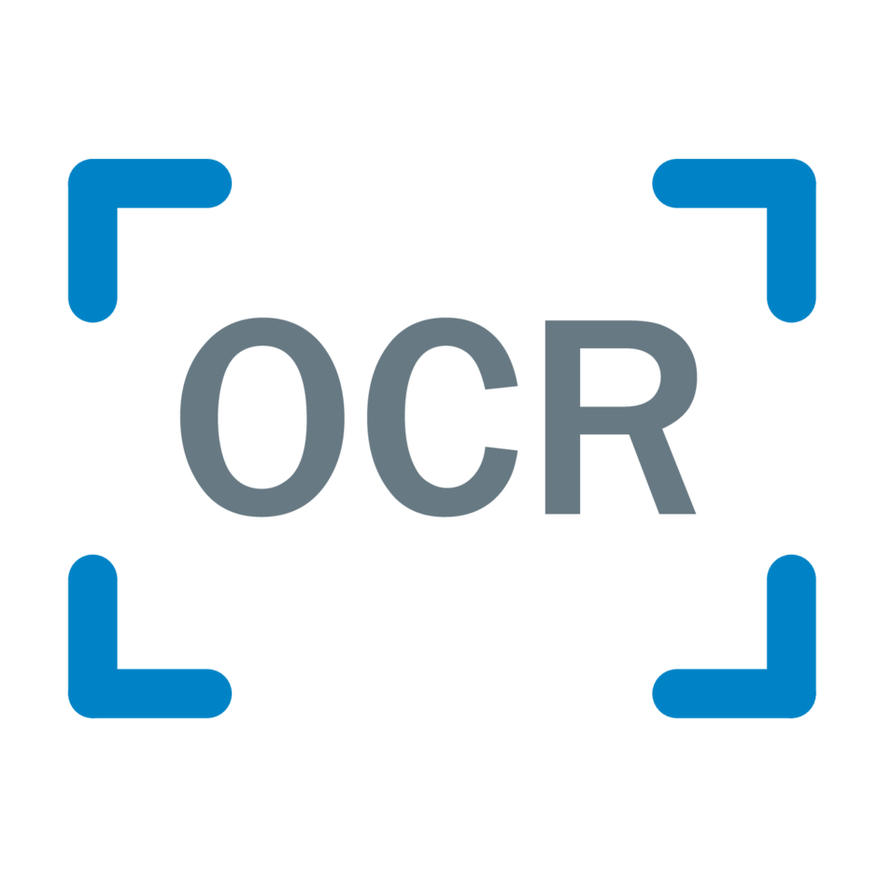
OCR (Optical Character Recognition)
DyselxiScan uses Apple’s Vision framework to extract the text from the captured image. One of Vision’s many powerful features is its ability to detect and recognize multilanguage text in images. Processing for image to text is handled on device itself to increase privacy.
Notes:
D : OCR or Optical Character Recognition, is a technology that allows computers to read text from images. This is how DyslexiScan captures the written text in the first place. This is done on the device itself

Slide 10
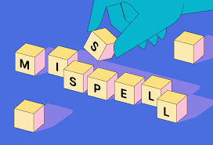
Spell checker
Our app uses UITextChecker for spell checking and providing some preprocessing for Gemini's sentence correction. Correcting the spelling mistake or words that do not exist helps take off load from Gemini.
Once you have the corrected versions of the misspelled words from UITextChecker, this text is forwarded to Gemini for further processing.
Notes:
V: The spell checker helps identify any misspelled words and corrects them, providing Gemini with a better prompt. This increases accuracy of our application.

Slide 11
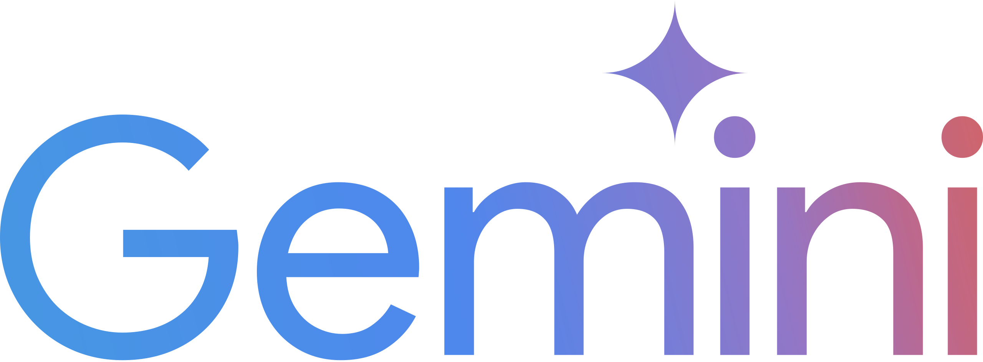
Gemini and Final Text
Gemini can analyze text input more deeply than traditional spell checkers like UITextChecker. It can understand context, semantics, and syntax to a higher degree.
Gemini helps reconstruct sentences to ensure they are meaningful and coherent after corrections are made. It can assist in rearranging words or phrases to improve readability and clarity.
Notes:
D: Then Gemini plays a crucial role in understanding the context and making intelligent adjustments to the captured text. This can involve correcting letter reversals or reorganizing scrambled words and most importantly finding the sense of the sentence and even rewriting if required.

Slide 12

Text to Speech
We have used speech synthesis made by apple for on device text to speech. This is done by AVSpeechUtterance instance that contains the text to speak. This allows people with Dyslexia to listen to text in place of reading. This helps them overcome the hurdle of reading.
Notes:
V: The app also allows people with Dyslexia to listen to text in place of reading. This helps them overcome the hurdle of reading.

Slide 13
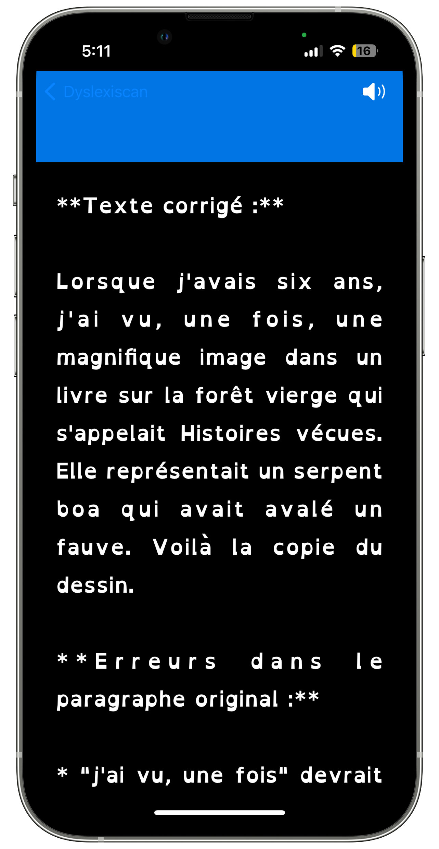
Multilingual Support
Our application can currently work with all Latin-based languages and Chinese(both Simplified and Traditional). This includes languages such as :-
English
French
Italian
German
Spanish
Portuguese
Chinese (both Simplified and Traditional)
Notes:
D : Not only that but our application supports all Latin-based languages and Chinese . Thus English, French, Italian, German, Spanish, Portuguese and Chinese (both Simplified and Traditional) are supported.

Slide 14

Uses Dyslexic Font
Dyslexic Friendly font, is a specialized typeface designed to alleviate reading difficulties commonly experienced by individuals with dyslexia. It incorporates subtle changes in letter shapes and spacing to enhance readability and comprehension for dyslexic readers. By emphasizing letter differentiation and reducing visual crowding, dyslexic fonts can make text more accessible and less prone to confusion..
Notes:
V : We are also using Dyslexic Friendly Font in our application which helps a dyslexic person read better. Dyslexic Font is special as it incorporates subtle changes in letter shape and adds much more spacing between letters to enhance readability.

Slide 15
Future Improvement
Development of an Android Application
Showing errors made by Student’s for their improvement
Improvement in Text Recognition
Custom trained Dyslexic Model
Notes:
D: We're constantly working to improve DyslexiScan. Future versions may include features like integration with educational tools, dev of an android application , showing error made in text for child’s development , improvement in text recognition and we are working on custom trained model for conversion of dyslexic text in normal text.

Slide 16
Bibliography
Xcode (IDE for app development) :- https://developer.apple.com/xcode/
Google Gemini :- https://gemini.google.com/app
Spell Checker :- https://developer.apple.com/documentation/uikit/uitextchecker
OCR :- https://developer.apple.com/documentation/vision/recognizing_text_in_images
Images for testing :- https://learningabledkids.com/learning_disability_ld/grade-by-grade-progress.htm
Notes:
V: Here you'll find a list of resources we used to develop this presentation and the application itself.

Slide 17
Thank You
- By Veerjyot Singh and Dhruv Gautam
Notes:
Both :Thank you for your time! We hope you found this presentation informative. We are happy to answer any questions you may have.

